Slide 1

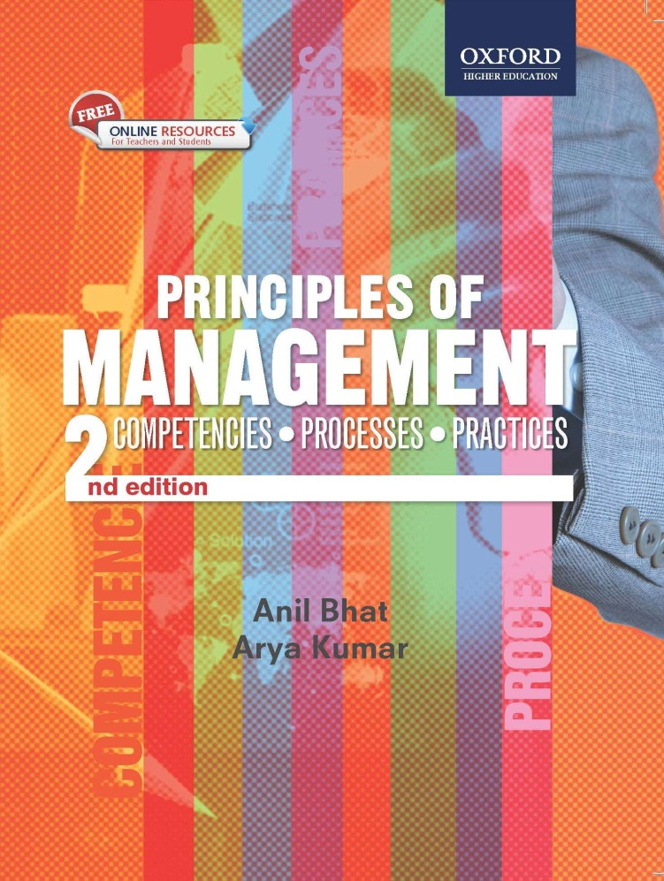
Principles of
Management ,2e
Anil Bhat
Arya Kumar

Slide 2
Management Control

Slide 3
Learning Objectives
Understand the importance of control as a management function
Understand how control is an essential function for achieving goals
Learn about important features and characteristics of controlling
Understand about steps involved in controlling
Learn about importance of budgeting as a tool of control
Learn about balanced scorecard as a strategy management control tool

Slide 4
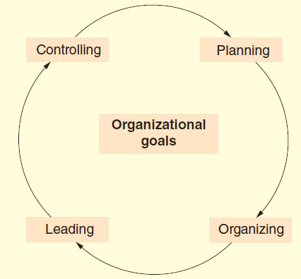
Why is Control Essential?
The best plan, organizational structure, and leader who inspires and motivates the team members may not ensure that activities happen as desired and people in the organization necessarily work towards achievement of the goals.
Control becomes an imperative tool that ensures that organizational goals will be achieved and if not, the reasons for the same
Management functions to achieve organizational goals

Slide 5
Features and Characteristics of Controlling
Controlling is one of the key managerial functions and without incorporation of this aspect, other three functions of management will not be able to give the required results.
Continuous Controlling involves continuous feedback mechanism in the organization on the basis of analysis of objectives, policies, procedures and performance variables.
All levels and all pervasive Controlling has to be at different levels in the organization along with all the activities that are undertaken by different functionaries to achieve overall goals of the organization and if deviations, reasons for the same.
Future perspective Controlling is just an onward looking activity. Analysis of past should give a foresight to the managers to take corrective action and curative measures to overcome the mistakes made in the past.

Slide 6
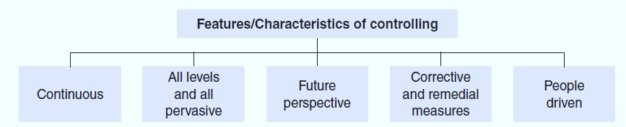
Features and Characteristics of Controlling
Corrective and remedial measures The purpose of a control mechanism is to have timely corrective and curative measures, which ought to be based on the factual and objective feedback mechanism.
People driven Control is necessarily a people driven process and thus employees need to be vigilant, alert, and self-disciplined to exercise control.

Slide 7
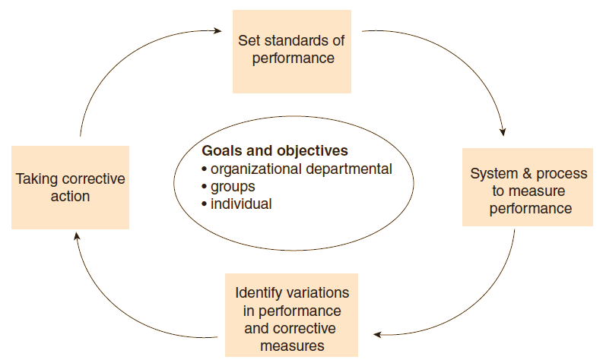
Steps involved in controlling

Slide 8
Techniques to control
One of the prominent techniques used to control is budget, which specifies the expected standards to be achieved.
Budgetary control is a process of comparing the actual outcomes with the pre-set budget data to establish achievements and accomplishments and to take necessary actions for overcoming the variations by either making corrections in the budget estimates or by taking corrective steps to overcome the differences.

Slide 9
Techniques to control
Some of the commonly used budgets are sales budget, selling and distribution cost budget, production budget, cost of production budget, purchase of raw materials budget, cash budget, and budget for profit and loss account.
The budget should be made in such a way that it helps in overcoming any wastage of time and resources.

Slide 10
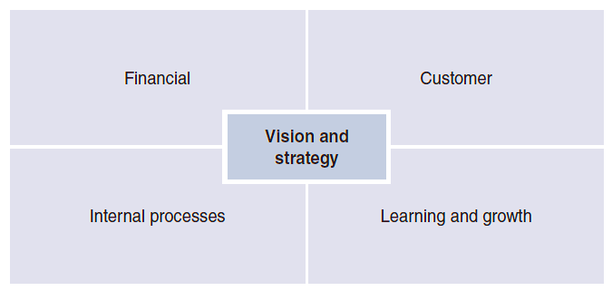
Balanced scorecard as a strategic management control tool
This performance measurement system includes financial measures and nonfinancial drivers for future financial outcomes. The non-financial drivers are related to customer, internal processes, learning, and growth. It is a framework that considers both outcome and processes, and internal and external perspectives of different stakeholders’ interests.

Slide 11
Types of Control
Feedback control: It is a post mortem examination of events, the purpose is to improve performance in the future.
Concurrent Controls: Monitoring ongoing activities to ensure they are consistent with the standards.
Feedforward Control: It is intelligent anticipation of the problem and timely prevention.

Slide 12
THANK YOU

